Slide 1
Reactive Java Demo

Slide 2
Long Polling
Client A
Server
Client B
Anything new?
Waiting
Nope
Anything new?
Waiting
Yes
New Message!
Anything new?
Waiting
Nope
New Message!
Anything new?

Slide 3
Realtime Proxy
Realtime A
Client A
Realtime Proxy
Realtime B
Client B
Notes:
Realtime Proxy 作用类似WIP 但是比WIP稳定
Load Balance
断开重连
自动剔除不健康节点

Slide 4
Blocking APIs VS Non-Blocking APIs(Reactive)
Blocking
Thread1
Non-Blocking
Thread 1
Non-Blocking
Thread 2
Httpclient
Netty
Netty
Service
Service

Slide 5
Micro Service Gateway
Client A
Client B
API Gateway
Micro Services

Slide 6
Spring Cloud Netflix VS Spring Cloud Gateway
Spring Cloud Netflix | Spring Cloud Gateway
spring-boot-starter-tomcat | Spring-boot-starter-reactor-netty
Blocking APIs | Non-blocking APIs
Doesn’t support long lived connections | Websockets are supported
Notes:
Reactive and non-blocking generally do not make applications run faster. They can, in some cases, (for example, if using the WebClient to run remote calls in parallel). On the whole, it requires more work to do things the non-blocking way and that can slightly increase the required processing time.
The key expected benefit of reactive and non-blocking is the ability to scale with a small, fixed number of threads and less memory. That makes applications more resilient under load, because they scale in a more predictable way. In order to observe those benefits, however, you need to have some latency (including a mix of slow and unpredictable network I/O). That is where the reactive stack begins to show its strengths, and the differences can be dramatic.
https://docs.spring.io/spring-framework/docs/current/reference/html/web-reactive.html

Slide 7
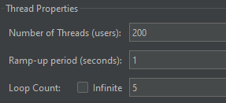
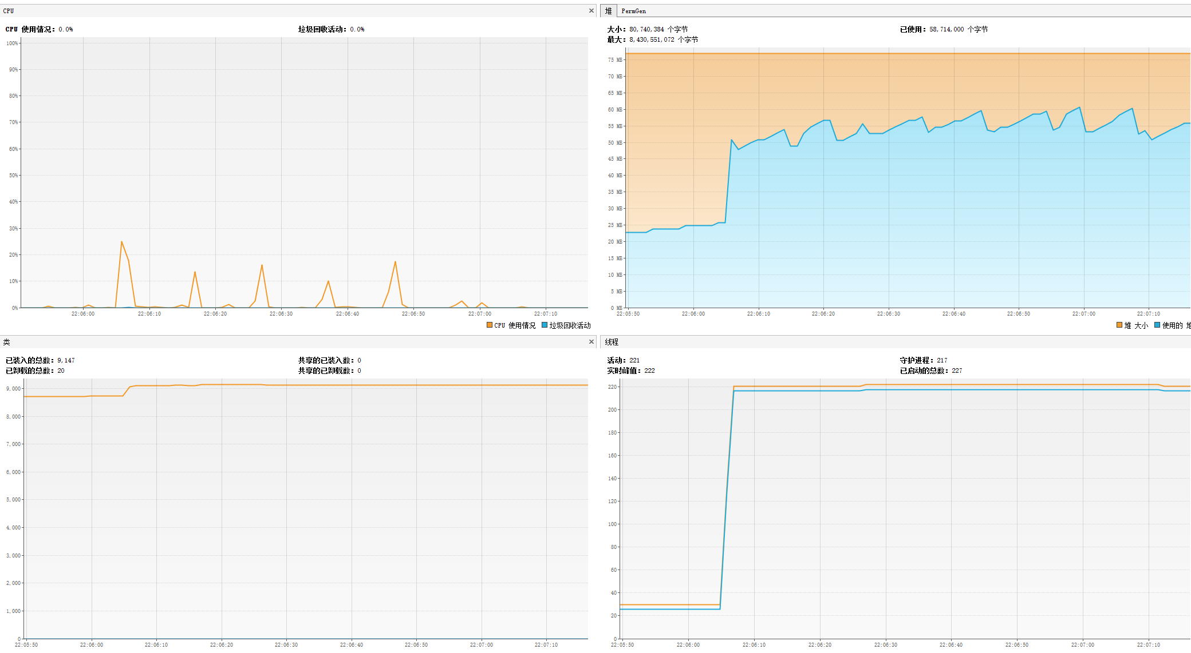
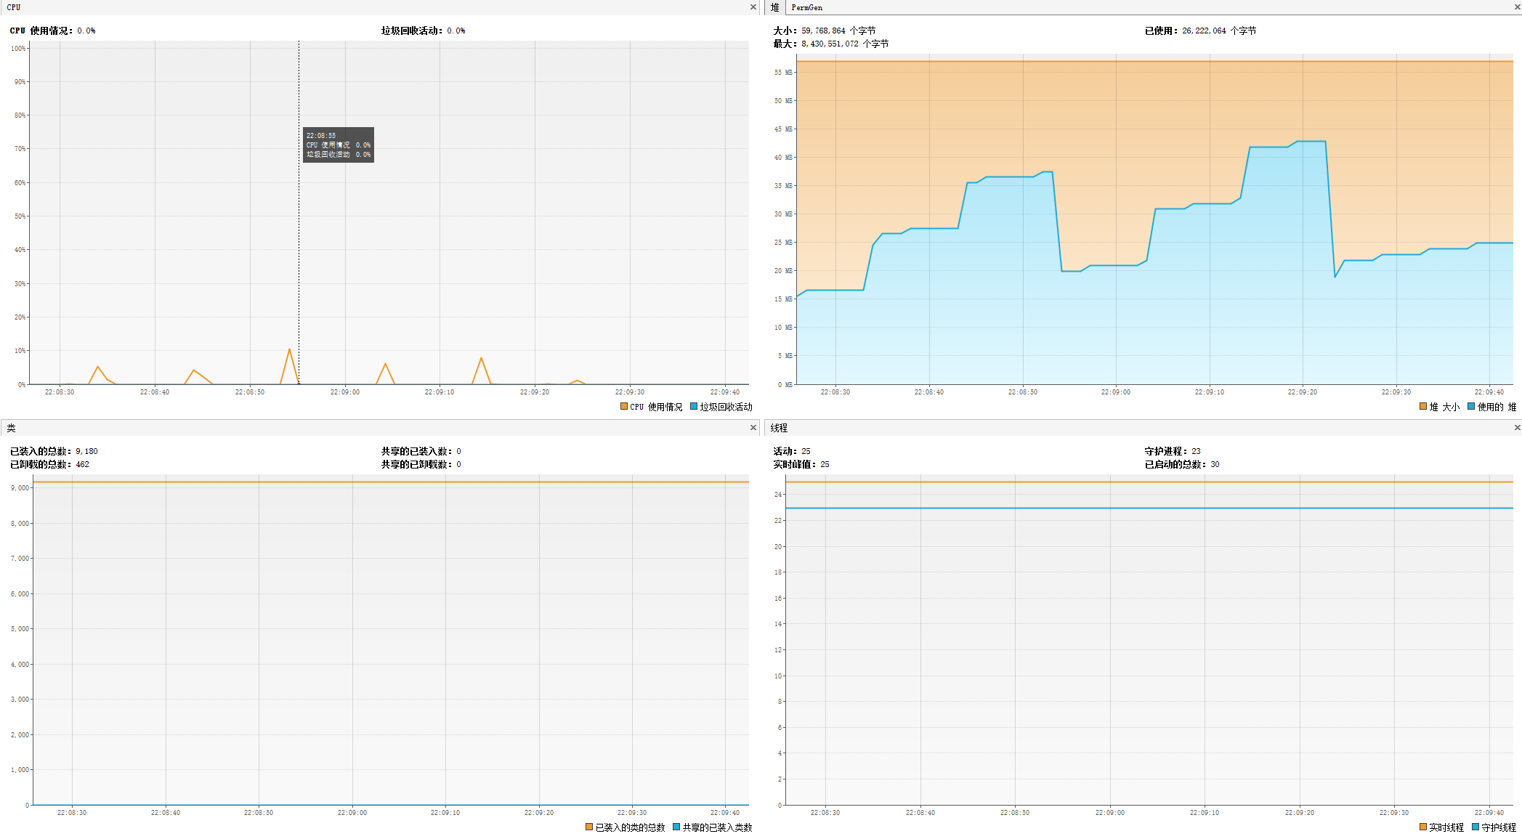
Spring Cloud Netflix VS Spring Cloud Gateway
200 concurrent users call backend service. And loop count is 5.
Netflix Zuul:
Spring Gateway:

Slide 8
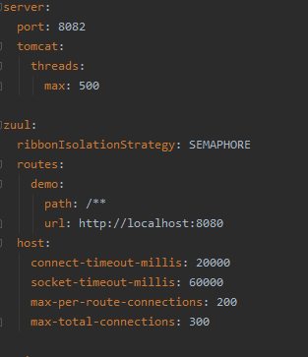
Netflix Zuul

Slide 9
Spring Gateway:

